Slide 1
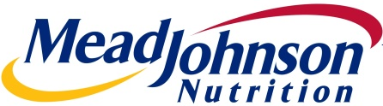
Mead Johnson Nutrition Company
Initiating Coverage
March 20th 2016
Valay Shah
All Figures in $USD unless noted otherwise

Slide 2
Executive Summary
UPSIDE
6.6%
CURRENT
TARGET
$75.79
$80.79
Brand Name
China’s Two Child Policy
Low Dairy Prices
Shifting Consumer Preferences
Oligopoly – High Barriers to Entry
New, Fully Imported Formula into China
Recommendation
HOLD
Appendix

Slide 3
Mead Johnson Share Price Since Inception
Two high level factors contributing to the 2015 Slide:
Back to back EPS misses
Sales forecast downgrade announcement from 6% to 4% in Q2 2015 -> CEO said Chinese growth was overly optimistic
Company split into nutrition and pharmaceuticals
Appendix
Notes:
4 factors of What happened in 2015?
Little bit of info about split in 2009

Slide 4
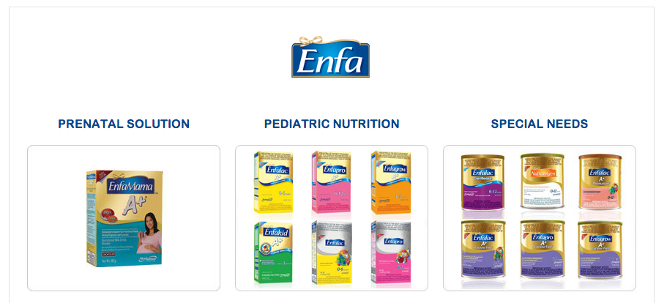
Mead Johnson Nutrition Business Overview
With over 100 years of experience, Mead Johnson Nutrition Company manufactures, distributes, and sells infant formulas, children’s nutrition, and other nutritional products
Is one of the Big 4 baby formula companies along with Nestle, Danone, and Abbott Laboratories
Product Mix
Financial Overview
Market Data
Share Price | $75.79
Market Cap | $13,410 M
Net Debt | $1,322 M
EV | $14,732 M
Dividend Yield | 2.3%
Beta (5 Year) | 0.98
Credit Rating | BBB
LTM Income Profile
Revenue | $4,071 M
Gross Profit | $2,616 M
EBIT | $936M
Net Income | $654M
NI Margin | 16.0%
LTM Diluted EPS | $3.3
NTM Diluted EPS | $3.5
Revenue Growth
CAGR = 6%
Multiples
EV/Revenue LTM | 3.9x
EV/Revenue NTM | 4.0x
EV/EBITDA LTM | 14.5x
EV/EBITDA NTM | 14.9x
P/E LTM | 23.6x
P/E NTM | 22.1x
MC/LFCF | 18.2x
Ratios
D/E | 21%
ROA | 15.1%
ROC | 25.7%
Debt/EBITDA | 2.8x
EBITDA/Interest Expense | 14.6x
CAGR = 4%
Source: S&P Capital IQ
Appendix
Notes:
CAGR revenue growth YoY projections were 6% until mid 2015 when they were lowered to 4%*
I think 6% makes sense because of the two child policy effective January 1, 2016

Slide 5
Competitive Positioning
US Formula Market
=$33B
Global Infant Nutrition Market
China Formula Market
=$8B
Global Formula Market
=$55B
Appendix
Notes:
Global Formula Market is not computed via sales*

Slide 6
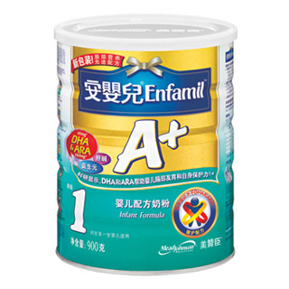
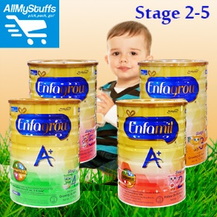
Breakdown of Sales for MJN
Children’s nutrition is primarily composed of whole milk powder or concentrate for young toddlers
The products are very similar (basically a pure play company even with this minor segmentation)
Mead Johnson Sales 2015
=$4.1B
Mead Johnson Sales 2015
=$4.1B
Appendix
Notes:
http://www.nielsen.com/us/en/press-room/2015/oh-baby-global-baby-food-and-formula-sales-will-reach-nearly-35-billion.html

Slide 7
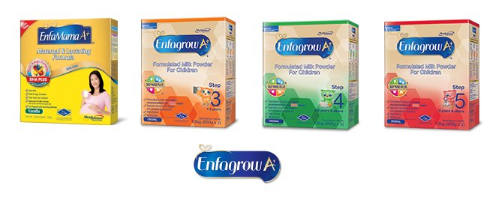
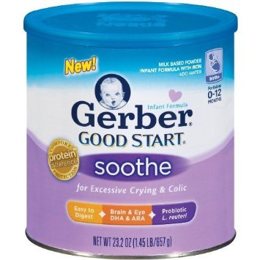
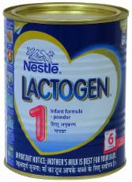
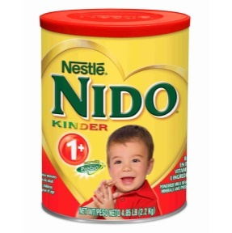
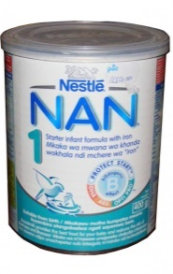
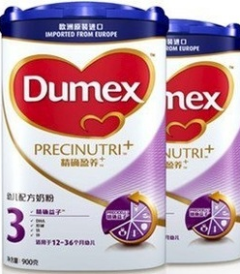
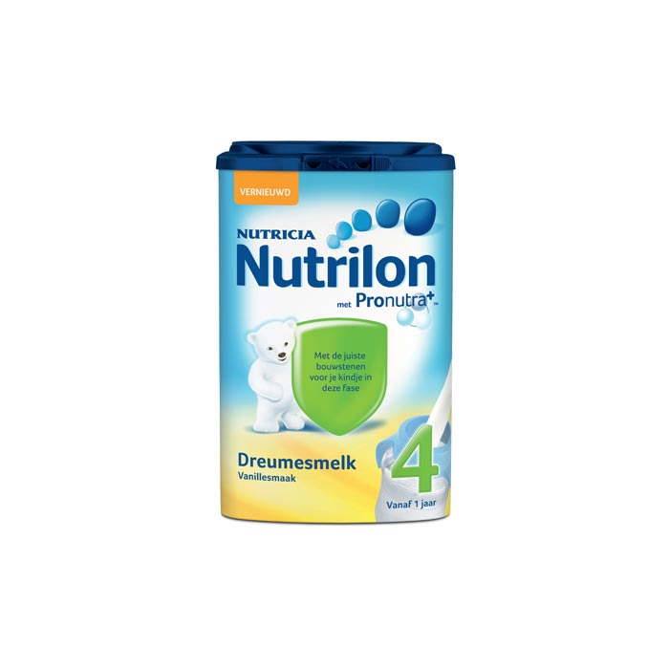
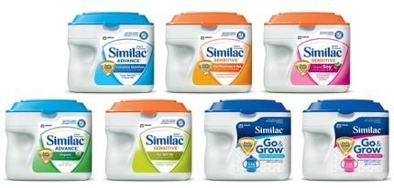
Premium Brands
Mead Johnson
Nestle
60% of PREMIUM infant formula is captured by the big four in China
Danone
Abbott Laboratories
Appendix
Notes:
http://www.foodnavigator-asia.com/Business/Nestle-ousts-infant-formula-competitors-in-China-with-significant-Pfizer-takeover
For the 60% statistic

Slide 8



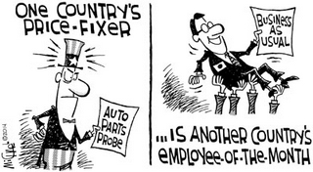
Biggest Risks of the Big 4
Mead Johnson
Nestle
Late on following consumer preferences (organic, imported formula, e-commerce)
Sales Rep or a Nurse?
MJN
Industry
Malnutrition among poor families
Death by formula – polluted water used
Danone
Abbott Laboratories
Danone is engaged in a marketing war with Nestle; it’s not going well
Settling collusion charges since the 70s
Nestle
Danone
Appendix
Notes:
http://www.foodnavigator-asia.com/Business/Nestle-ousts-infant-formula-competitors-in-China-with-significant-Pfizer-takeover
For the 60% statistic
MJN been late in 3 occasions:
Changing consumer trends in Organic food offerings
Fully imported baby formula product hit China in 2015! RIDICULOUS! It’s been 7 years since the melaphine scandal
Joker Scene Metaphor – sales rep dressed as a nurse, goes into the hospital, spews about formula products to mothers and comes out leaving families confused and in tatters – advocacy groups claim this causes two things:
Leaves families poorer and causes malnutrition because poor families who were planning on breastfeeding due to their economic situation end up purchasing premium, expensive formula for babies and may ration the product which leads to malnourished babies
Poor sanitation of water and polluted water mixed in with powder can cause death to babies due to their weak immune systems
Abbott Laboratories – price collusion has been occuring since the 1970s
http://www.nytimes.com/1996/05/25/business/abbott-agrees-to-settle-baby-formula-suit.html

Slide 9
Competitive Positioning
Mead Johnson
Nestle
Enfamil is a highly premium brand
Highest gross margins among the Big 4
Science based approach to formula
Late to react to changing formula trends
Acquired Pfizer’s Infant Nutrition segment
Very large presence in India (85% share)
More diversified product lines for all ages
Marketing campaign breaches international standards (led to boycotts)
Danone
Abbott Laboratories
Market leader in China with their acquisition of Numico in 2007
Lost joint venture with Mead Johnson to acquire Pfizer Nutrition/Wyeth in 2012
Untruthful marketing tactics (panic buying in the UK in 2012) breaches intl. standards
Most consumer facing company of the four
First company to launch non-GMO formula
Abbott has a history of settlements related to price fixing since the 1970s
Recall in 2013 due to cases of botulism
Appendix
Notes:
MJN
http://www.fool.com/investing/general/2014/04/26/what-formula-brings-success-for-this-infant-formul.aspx
Rigorous testing (over 2000 safety and quality checks are put in place) of it’s products ensures high quality
Late to react to changing formula trends (1. Organic offerings 2. China’s rise of e-commerce 3. Full imported products into China)
E-commerce boom is just a bunch of people are now buying premium products online that get imported straight into China (once again the theme comes up where there is a craze about imported products)
Nestle
Acquired Pfizer’s Infant Nutrition segment in 2012 to gain a stronghold in developing markets
Save the Children, discovered that Nestle's sales representatives contacted Chinese mothers directly to promote the company's baby milk formula. This deprived these mothers of the opportunity of considering another alternative, like breast milk. Acts like this could be detrimental to Nestle's brand image and led to boycotts for breastfeeding advocates
They also had sales reps dressed in nurse outfits appear at hospitals
http://www.theguardian.com/sustainable-business/nestle-baby-milk-scandal-food-industry-standards
Nestle is the target for many activists due to their discouraging of breastfeeding to mothers and exploitation of them back in the 1970s which caused deaths of babies due to poverty which lead to malnutrition of babies along with unsanitary, polluted water being used – Nestle’s response to this? They told the advocates to go to Africa and Asia and “clean their water”
The Nestle boycott is STILL in place by Baby Milk Action (UK advocacy group) and 102 business in the UK due to the
Danone
http://www.babymilkaction.org/archives/641
Danone’s premium paid for Numico of 22x EBITDA was higher than Nestle’s of Pfizer’s and Nestle’s of Gerber in 2007 (same year as Numico) of only 16x EBITDA
Most of Danone’s woes come from the fact that it is engaged in a bitter, marketing war with Nestle
Danone is accused of panic buying in the UK by saying that people are buying a bulk of their products and sending them overseas to China; this was proven untrue by UK government officials and Danone was accused of panic buying
Danone also slaps on WHO and UNICEF slogans on their products saying things like “Half a litre a day” and slapping on WHO’s logo beside it to make it appear as though WHO is endoresing their product. In reality, WHO and UNICEF DO NOT endorse their product! Pure lie and fabrication.
http://www.independent.co.uk/news/uk/home-news/after-nestl-aptamil-manufacturer-danone-is-now-hit-by-breast-milk-scandal-8679226.html
Abbott Laboratories
http://seekingalpha.com/article/1329321-abbott-laboratories-golden-goose-the-nutrition-business
http://www.dairyreporter.com/Manufacturers/Abbott-Laboratories-launching-non-GMO-Similac-infant-formula-in-US
Non-GMO formula first launched by Nestle in South Africa but Abbott is the first in North America also Mead Johnson also introduced non-GMO products as well
The recall helped out MJN tremendously as it’s revenues grew by 21% YoY in Latin America (cited on MJN’s 10K)
Botulism is a case of drooping of eyelids
http://www.bizjournals.com/chicago/news/2013/08/07/abbott-labs-double-whammy-in-china.html
Th c

Slide 10
Industry Strengths and Risks
Strengths
Risks
Brand Image is paramount above all else
Oligopoly in most markets (The Big 4)
High barriers to entry – need to establish brand image
Consumer preferences in Asia-Pacific about baby formula help the industry
2008 Melamine disaster has shifted consumer confidence towards premium brands
Two Child Policy in China will add 85 million incremental babies by 2020
Relatively stable industry with some price inelasticity
Declining population growth is offset by increase in wealth; larger working class can buy more premium baby formula products
A single, baseless scandal can destroy large swaths of value ex) Synutra
Products are highly regulated by the government – difference between non-premium brands and premium brands in developed nations is minimal
Shifting customer preferences in the developed world
Too competitive between the Big Four leads to cheating
Large marketing dollars needed to convince parents of superiority of premium baby formula vs. breast milk & non-premium
Appendix
Notes:
Strengths:
High barriers to entry – other companies will buy you out
Premature breast development source:
http://www.businessweek.com/globalbiz/blog/eyeonasia/archives/2010/08/baby_formula_scare_hurts_chinas_synutra.html

Slide 11
Investment Catalysts & Risks
Investment Catalysts
Investment Risks
2nd in global market share and only pure play among the Big 4
Most recognizable formula brand name
Highest gross margins among the Big 4
Seems more ethical than other companies
Industry strengths have a greater impact due to the company being pure play
Least diversified company among the Big 4 (pure player); exposure to dairy prices is therefore accentuated
All industry risks are also accentuated including customer preferences
Management is slow to catch onto trends
Highest exposure to China among comps
Forex (Daily)
Milk Prices (Monthly)
Stock Price
Exchange Rate to USD
VaR Daily (5%) – (2.24)% VaR Monthly (5%) – (8.24)%
VaR Daily (10%) – (1.65)% VaR Monthly (10%) – (6.83)%
Appendix
Notes:
The forex graph correlation is based on daily fluctuations
MJN
http://www.fool.com/investing/general/2014/04/26/what-formula-brings-success-for-this-infant-formul.aspx
Rigorous testing (over 2000 safety and quality checks are put in place) of it’s products ensures high quality
Late to react to changing formula trends (1. Organic offerings 2. China’s rise of e-commerce 3. Full imported products into China)
E-commerce boom is just a bunch of people are now buying premium products online that get imported straight into China (once again the theme comes up where there is a craze about imported products)
Nestle
Acquired Pfizer’s Infant Nutrition segment in 2012 to gain a stronghold in developing markets
Save the Children, discovered that Nestle's sales representatives contacted Chinese mothers directly to promote the company's baby milk formula. This deprived these mothers of the opportunity of considering another alternative, like breast milk. Acts like this could be detrimental to Nestle's brand image and led to boycotts for breastfeeding advocates
They also had sales reps dressed in nurse outfits appear at hospitals
http://www.theguardian.com/sustainable-business/nestle-baby-milk-scandal-food-industry-standards
Nestle is the target for many activists due to their discouraging of breastfeeding to mothers and exploitation of them back in the 1970s which caused deaths of babies due to poverty which lead to malnutrition of babies along with unsanitary, polluted water being used – Nestle’s response to this? They told the advocates to go to Africa and Asia and “clean their water”
The Nestle boycott is STILL in place by Baby Milk Action (UK advocacy group) and 102 business in the UK due to the
Danone
http://www.babymilkaction.org/archives/641
Danone’s premium paid for Numico of 22x EBITDA was higher than Nestle’s of Pfizer’s and Nestle’s of Gerber in 2007 (same year as Numico) of only 16x EBITDA
Most of Danone’s woes come from the fact that it is engaged in a bitter, marketing war with Nestle
Danone is accused of panic buying in the UK by saying that people are buying a bulk of their products and sending them overseas to China; this was proven untrue by UK government officials and Danone was accused of panic buying
Danone also slaps on WHO and UNICEF slogans on their products saying things like “Half a litre a day” and slapping on WHO’s logo beside it to make it appear as though WHO is endoresing their product. In reality, WHO and UNICEF DO NOT endorse their product! Pure lie and fabrication.
http://www.independent.co.uk/news/uk/home-news/after-nestl-aptamil-manufacturer-danone-is-now-hit-by-breast-milk-scandal-8679226.html
Abbott Laboratories
http://seekingalpha.com/article/1329321-abbott-laboratories-golden-goose-the-nutrition-business
http://www.dairyreporter.com/Manufacturers/Abbott-Laboratories-launching-non-GMO-Similac-infant-formula-in-US

Slide 12
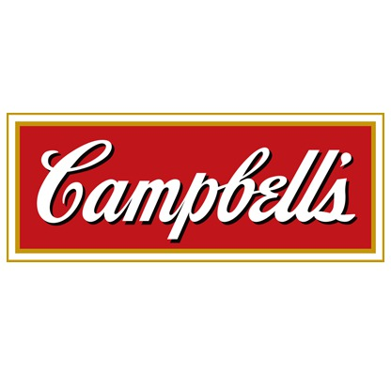
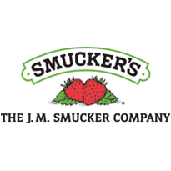
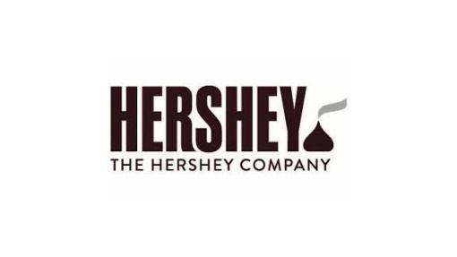
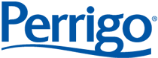
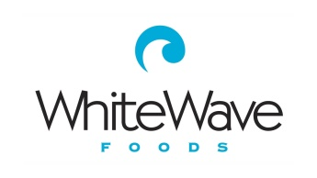
Comparable Analysis
Comparable Companies Criteria
US Based
Beverages or Dairy product Companies
Revenues between $3-$8B (Rounded to nearest Billion)
Companies must be focused on one type of product offering or derive most of their revenues from one type of product offering
Appendix

Slide 13
Comparable Analysis Multiples
Appendix

Slide 14
Comparable Analysis Margins and Profitability
Appendix

Slide 15
Revenue LTM and NTM
Revenue Projection Process:
Took global population growth projections for infants (0-24 months) for segmented regions
Got breastfeeding rates for segmented regions
Took the % of infant population not being breastfed for the different regions
Got the revenue growth rates by each region based on population metric as well as other sources and also took into account the effects of forex fluctuations on revenue and the effect of dairy price fluctuations on COGS. For China, incremental effect of 2 child policy was also taken into account
Took 2016-2020 sales projections, convergence was from 2021-2030 and 2030 onwards was the terminal growth rate which was also based on population growth metrics (CAGR 2015-2030)
Base Quarterly Revenues
Base Annual Revenues
CAGR = 6%
CAGR = 4%
Appendix

Slide 16
WACC
Regression WACC = 7.9%
Beta = 0.979
80%
WACC = 7.55%
Comps WACC = 6.2%
Beta = 0.618
20%
Appendix

Slide 17
DCF - Base
Exit Multiple Method
EV/EBITDA NTM = 14.9x
Target Price = $92.16
50%
Target Price = $80.79
Upside = 6.6%
Terminal Value Method
Terminal Growth Rate = 0.52%
Target Price = $69.47
50%
Appendix

Slide 18
Projected Free Cash Flows
Base Case
Bear Case
Bull Case

Slide 19
Investment Summary
Valuation Range (USD)
Shifting Consumer Preferences
Current Price: 75.79
Target Price: $80.79 Upside: 6.6%
Recommendation: HOLD
Strength of USD in the Future
Impact of the Two Child Policy
Dairy Price Projections
Excessive Competition Leading to Legal Troubles
Appendix

Slide 20

Q&A

Slide 21
Revenue - Population Projections
World Bank Data
Appendix

Slide 22
Revenue Growth Assumptions – Breastfeeding Rates
American Rates
Chinese Rates
Latin America Rates - Mexico
Europe Rates
Other Asia Rates - Indonesia
R.O.W Rates – Average of Australia, Nigeria, and Egypt
Appendix

Slide 23
Bear, Base, Bull Cases for Population Growth
Appendix

Slide 24
Revenue & COGS Assumptions – Global Market
Global Market Assumptions
The Following are Applied to All Relevant Segments
Appendix

Slide 25
Revenue Assumptions – Segmented
China
China
China
Appendix

Slide 26
Revenue Assumptions Summary – Base & Bear
Appendix

Slide 27
Revenue Assumptions Summary – Bull
The bolded numbers are what was used to calculate the revenue in future years
Other Assumptions:
Appendix

Slide 28
EPS Estimate Calculations
The adjusted Q1 EPS (average of Q1 and Q4) and Adjusted Q4 EPS (average of all four quarters) were utilized instead of the Base Q1 and Q4 due to reasonability
Appendix

Slide 29
Correlation Matrix
Mead Johnson is the company most adversely affected by Milk Prices
Danone is the company most adversely affected by fluctuation in the forex rates (for all the different foreign exchange presented here)
Mead Johnson’s performance depends greatly on milk prices since it is a pure player in the industry
Nestle and Danone are the two companies most impacted by the strength of the USD. Although all four companies are negatively impacted by this, Nestle and Danone generate more of their income internationally than Mead Johnson and Abbott Laboratories and thus fluctuations in the USD affect them the most
Appendix

Slide 30
What is Baby Formula?
There are three types of baby formulas:
Cow milk protein-based formulas - Most infant formula is made with cow's milk that's been altered to resemble breast milk. This gives the formula the right balance of nutrients — and makes the formula easier to digest. Most babies do well on cow's milk formula.
Soy-based formulas - Soy-based formulas can be useful if you want to exclude animal proteins from your child's diet. Soy-based infant formulas might also be an option for babies who are intolerant or allergic to cow's milk formula or to lactose, a carbohydrate naturally found in cow's milk.
Protein hydrolysate formulas - These types of formulas contain protein that's been broken down (hydrolyzed) — partially or extensively — into smaller sizes than are those in cow's milk and soy-based formulas. Protein hydrolysate formulas are meant for babies who don't tolerate cow's milk or soy-based formulas
…which come in three forms:
Powder—the least expensive of the infant formulas. It must be mixed with water before feeding (most popular) Side Note: In the 1970s Nestle came under fire for going to 3rd world countries and exploiting uneducated mothers by selling them powdered formula – this later led to widespread death among babies in areas of Africa and Asia because these premium brands led to poverty for families and the water mixed with the powder was often unclean
Liquid concentrate—must be mixed with an equal amount of water (least popular)
Ready-to-feed—the most expensive form of formula that requires no mixing (most convenient)
Appendix
Notes:
http://www.mayoclinic.org/healthy-lifestyle/infant-and-toddler-health/in-depth/infant-formula/art-20045782

Slide 31
Competitive Positioning
Mead Johnson
Nestle
Enfamil is considered a highly premium brand and is recommended by pediatricians in the U.S
Rigorous testing (over 2000 safety checks) of it’s products ensures high quality
Highest gross margins among the Big 4
Science based approach to formula (smarter instead of tastier)
Late to react to changing formula trends
Acquired Pfizer’s Infant Nutrition segment in 2012; 85% of sales of that segment were in developing nations (high growth)
Very large presence in India (85% share)
More diversified product lines for all ages
Marketing campaign breaches international standards (led to boycotts)
Unethical history – 1970s boycott due to exploitation of LEDCs women
Danone
Abbott Laboratories
Became a market leader in China with their acquisition of Numico in 2007
Reaction breached intl. formula marketing standards has been ethical (50% violations reduction vs. 3% for Nestle)
Lost joint venture with Mead Johnson to acquire Pfizer Nutrition/Wyeth in 2012
Untruthful marketing tactics (panic buying in the UK in 2012) breaches intl. standards
Most consumer facing company of the bunch (50% of nutrition sales come from patients and customers not 3rd parties
Similac Total Comfort is the industry standard for infants with digestive issues
First company to launch non-GMO formula
Abbott has a history of settlements related to price fixing since the 1970s
Recall in 2013 due to cases of botulism
Appendix
Notes:
MJN
http://www.fool.com/investing/general/2014/04/26/what-formula-brings-success-for-this-infant-formul.aspx
Rigorous testing (over 2000 safety and quality checks are put in place) of it’s products ensures high quality
Late to react to changing formula trends (1. Organic offerings 2. China’s rise of e-commerce 3. Full imported products into China)
E-commerce boom is just a bunch of people are now buying premium products online that get imported straight into China (once again the theme comes up where there is a craze about imported products)
Nestle
Acquired Pfizer’s Infant Nutrition segment in 2012 to gain a stronghold in developing markets
Save the Children, discovered that Nestle's sales representatives contacted Chinese mothers directly to promote the company's baby milk formula. This deprived these mothers of the opportunity of considering another alternative, like breast milk. Acts like this could be detrimental to Nestle's brand image and led to boycotts for breastfeeding advocates
They also had sales reps dressed in nurse outfits appear at hospitals
http://www.theguardian.com/sustainable-business/nestle-baby-milk-scandal-food-industry-standards
Nestle is the target for many activists due to their discouraging of breastfeeding to mothers and exploitation of them back in the 1970s which caused deaths of babies due to poverty which lead to malnutrition of babies along with unsanitary, polluted water being used – Nestle’s response to this? They told the advocates to go to Africa and Asia and “clean their water”
The Nestle boycott is STILL in place by Baby Milk Action (UK advocacy group) and 102 business in the UK due to the
Danone
http://www.babymilkaction.org/archives/641
Danone’s premium paid for Numico of 22x EBITDA was higher than Nestle’s of Pfizer’s and Nestle’s of Gerber in 2007 (same year as Numico) of only 16x EBITDA
Most of Danone’s woes come from the fact that it is engaged in a bitter, marketing war with Nestle
Danone is accused of panic buying in the UK by saying that people are buying a bulk of their products and sending them overseas to China; this was proven untrue by UK government officials and Danone was accused of panic buying
Danone also slaps on WHO and UNICEF slogans on their products saying things like “Half a litre a day” and slapping on WHO’s logo beside it to make it appear as though WHO is endoresing their product. In reality, WHO and UNICEF DO NOT endorse their product! Pure lie and fabrication.
http://www.independent.co.uk/news/uk/home-news/after-nestl-aptamil-manufacturer-danone-is-now-hit-by-breast-milk-scandal-8679226.html
Abbott Laboratories
http://seekingalpha.com/article/1329321-abbott-laboratories-golden-goose-the-nutrition-business
http://www.dairyreporter.com/Manufacturers/Abbott-Laboratories-launching-non-GMO-Similac-infant-formula-in-US
Non-GMO formula first launched by Nestle in South Africa but Abbott is the first in North America also Mead Johnson also introduced non-GMO products as well
The recall helped out MJN tremendously as it’s revenues grew by 21% YoY in Latin America (cited on MJN’s 10K)
Botulism is a case of drooping of eyelids
http://www.bizjournals.com/chicago/news/2013/08/07/abbott-labs-double-whammy-in-china.html
Th c

Slide 32
Industry Strengths and Risks
Strengths
Risks
Brand Image is paramount above all else
Oligopoly in most markets (The Big 4)
High barriers to entry – need to establish brand image, then you’ll be acquired by the Big 4 if successful
Consumer preferences in Asia-Pacific about baby formula help the industry
2008 Melamine disaster has shifted consumer confidence towards premium brands of formula only all across the globe
Two Child Policy in China will add 85 million incremental babies on top of the one child policy ones by 2020
Relatively stable industry with some price inelasticity as parents want to do what is best for their baby regardless of cost
Declining population growth worldwide is offset by increase in wealth; larger working class can buy more expensive, premium baby formula products; also more mothers working
A single, baseless scandal can destroy large swaths of value ex) Synutra with premature breast development accusation (Baseless and later proven False) = drop of 25%
Products are highly regulated by the government – difference between non-premium brands and premium brands in developed nations is minimal
Shifting customer preferences in the developed world with increase in breastfeeding
Too competitive between the Big Four leads to cheating – MJN itself has been involved in bribery settlements and fines for bribing nurses to recommend it’s products along with price fixing collusions
Large marketing dollars needed to convince parents of superiority of premium baby formula vs. breast milk & non-premium
Appendix
Notes:
Strengths:
High barriers to entry – other compaies will buy you out
Premature breast development source:
http://www.businessweek.com/globalbiz/blog/eyeonasia/archives/2010/08/baby_formula_scare_hurts_chinas_synutra.html

Slide 33
Investment Catalysts & Risks
Investment Catalysts
Investment Risks
2nd in global market share and only pure play player among the Big 4
Most recognizable formula brand name along with Similac (Abbott Laboratories)
Highest gross margins among the Big 4
Seems more ethical than other companies (no huge scandals besides collusion and Chinese hospital marketing)
Industry strengths have a greater impact due to the company being pure play
Least diversified company among the Big 4 (pure player); exposure to dairy prices is therefore accentuated
All industry risks are also accentuated including customer preferences
Management is slow to catch onto trends; not an innovative leader; more so a laggard (e-commerce, imported products, organic product offerings)
Highest exposure to China among comps
Appendix
Notes:
The forex graph correlation is based on daily fluctuations
MJN
http://www.fool.com/investing/general/2014/04/26/what-formula-brings-success-for-this-infant-formul.aspx
Rigorous testing (over 2000 safety and quality checks are put in place) of it’s products ensures high quality
Late to react to changing formula trends (1. Organic offerings 2. China’s rise of e-commerce 3. Full imported products into China)
E-commerce boom is just a bunch of people are now buying premium products online that get imported straight into China (once again the theme comes up where there is a craze about imported products)
Nestle
Acquired Pfizer’s Infant Nutrition segment in 2012 to gain a stronghold in developing markets
Save the Children, discovered that Nestle's sales representatives contacted Chinese mothers directly to promote the company's baby milk formula. This deprived these mothers of the opportunity of considering another alternative, like breast milk. Acts like this could be detrimental to Nestle's brand image and led to boycotts for breastfeeding advocates
They also had sales reps dressed in nurse outfits appear at hospitals
http://www.theguardian.com/sustainable-business/nestle-baby-milk-scandal-food-industry-standards
Nestle is the target for many activists due to their discouraging of breastfeeding to mothers and exploitation of them back in the 1970s which caused deaths of babies due to poverty which lead to malnutrition of babies along with unsanitary, polluted water being used – Nestle’s response to this? They told the advocates to go to Africa and Asia and “clean their water”
The Nestle boycott is STILL in place by Baby Milk Action (UK advocacy group) and 102 business in the UK due to the
Danone
http://www.babymilkaction.org/archives/641
Danone’s premium paid for Numico of 22x EBITDA was higher than Nestle’s of Pfizer’s and Nestle’s of Gerber in 2007 (same year as Numico) of only 16x EBITDA
Most of Danone’s woes come from the fact that it is engaged in a bitter, marketing war with Nestle
Danone is accused of panic buying in the UK by saying that people are buying a bulk of their products and sending them overseas to China; this was proven untrue by UK government officials and Danone was accused of panic buying
Danone also slaps on WHO and UNICEF slogans on their products saying things like “Half a litre a day” and slapping on WHO’s logo beside it to make it appear as though WHO is endoresing their product. In reality, WHO and UNICEF DO NOT endorse their product! Pure lie and fabrication.
http://www.independent.co.uk/news/uk/home-news/after-nestl-aptamil-manufacturer-danone-is-now-hit-by-breast-milk-scandal-8679226.html
Abbott Laboratories
http://seekingalpha.com/article/1329321-abbott-laboratories-golden-goose-the-nutrition-business
http://www.dairyreporter.com/Manufacturers/Abbott-Laboratories-launching-non-GMO-Similac-infant-formula-in-US

Slide 34
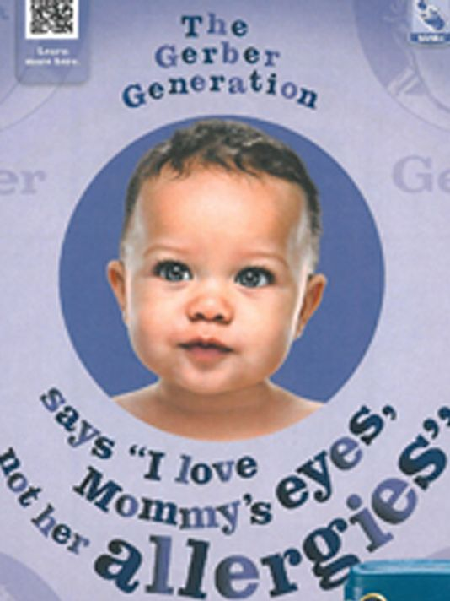

Enhanced Infant Formula
All premium infant formula brands have products which claim to “enhance” your baby
Mead Johnson’s Enfamil “Lipid” product line claims to better eyesight (picture bottom right)
Some infant formulas are enhanced with docosahexaenoic acid (DHA) and arachidonic acid (ARA). These are omega-3 fatty acids found in breast milk and certain foods, such as fish and eggs. Some studies suggest that including DHA and ARA in infant formula can help infant eyesight and brain development, but other research has shown no benefit
Most infant formulas are also iron-fortified which helps the baby grow and develop
Appendix
Notes:
http://www.mayoclinic.org/healthy-lifestyle/infant-and-toddler-health/in-depth/infant-formula/art-20045782

Slide 35
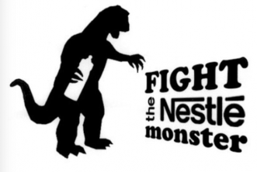
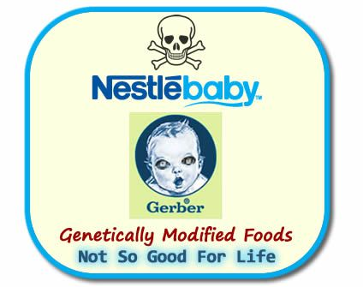
1970s Nestle Boycott
A boycott was launched in the United States on July 7, 1977, against the Swiss-based Nestlé corporation. It spread in the United States, and expanded into Europe in the early 1980s. It was prompted by concern about Nestlé's "aggressive marketing" of breast milk substitutes, particularly in less economically developed countries (LEDCs), largely among the poor. Organizers of the boycott encourage the practice of newborn nutrition via natural breast milk and claim that use of the substitutes represent a health risk for infants. As of 2013, the Nestlé boycott is STILL IN EFFECT and is coordinated by the International Nestlé Boycott Committee, the secretariat for which is the UK group Baby Milk Action.
Four Problems with Nestlé's marketing practices:
Formula must be mixed with water which is often polluted in developing nations and can wreak havoc on a baby’s immune system
Sanitation methods in developing nations are not optimal
Formula is very expensive so many mothers try to conserve formula by using less than is required
Breastfeeding has several health benefits that are non-existent in formulas such as protection from illnesses such as diarrhea, meningitis, gastroenteritis, ear infection, and respiratory infection. Breastfeeding also contains the right amount of ingredients for brain development and the bond between a mother and child is strengthened through breastfeeding
Appendix
Notes:
http://www.mayoclinic.org/healthy-lifestyle/infant-and-toddler-health/in-depth/infant-formula/art-20045782

Slide 36
Value at Risk (VaR)
Appendix

Slide 37
Synutra Share Price Comparison
Named one of the 21 Chinese companies that contained melamine in their formula
Falsely accused of premature breast development among young girls
Appendix

Slide 38
Mead Johnson 2015 Share Price Decline
Four underlying factors contributing to the 2015 Slide:
Dairy Decline – China is producing more milk domestically and reducing imports. 40% YoY decrease in imported milk powder
Supply Glut – China’s reduction has caused a global supply glut which means MJN and it’s competitors have lower input costs; but this has lead to competitors slashing prices which forced MJN to cut prices in Q2 2015 or risk losing market share
Importance of Imports – Market share and customer loyalty is paramount in this industry; once a customer switches, it can be hard to persuade them to switch back if the baby responds better to the new product. MJN introduced it’s first FULLY imported product in China in April 2015 (prior to this, the products were finished in China). Due to the 2008 scandal, mothers want products which are not touched in China. MJN took 7 years to implement this.
Shifting Consumer Trends – Government has implemented a two year plan to encourage mothers to breastfeed and wants the overall breastfeeding rates to rise to 50% (currently at 30% in rural areas and 16% in urban areas). Formula companies in China are not allowed to hand out free samples or market the products in hospitals. On July 28, 2015, MJN settled $12m with the SEC regarding marketing products in Chinese hospitals.
Appendix
Notes:
4 factors of What happened in 2015?
http://www.chicagobusiness.com/article/20150813/NEWS03/150819908/chinas-nursing-mothers-slower-growth-add-to-mead-johnson-woes
Little bit of info about split in 2009

Slide 39
Beta
Beta = 0.9795 versus S&P 500
Appendix

Slide 40
Comparable Analysis
Appendix

Slide 41
Comparable Analysis
Appendix

Slide 42
Comparable Analysis
Appendix

Slide 43
Comparable Analysis
Appendix

Slide 44
DCF - Bear
Exit Multiple Method
EV/EBITDA NTM (Median Comps) = 12.6x
Target Price = $58.74
50%
Target Price = $51.92
Upside = -32.77%
Terminal Value Method
Terminal Growth Rate = -1.01%
Target Price = $45.11
50%
Appendix

Slide 45
DCF - Bull
Exit Multiple Method
EV/EBITDA NTM (Max Comps) = 16.2x
Target Price = $143.86
50%
Target Price = $124.78
Upside = 61.55%
Terminal Value Method
Terminal Growth Rate = 1.00%
Target Price = $105.70
50%
Appendix

Slide 46
WACC - Regression
Appendix

Slide 47
WACC - Comps
Appendix

Slide 48
WACC - Comps
Appendix

Slide 49
DCF Base – FCFF Exit Multiple & Perpetual Growth Method
Appendix

Slide 50
DCF Base – Sensitivity Analysis
Appendix

Slide 51
DCF Bull – FCFF Exit Multiple & Perpetual Growth Method
Appendix

Slide 52
DCF Bull – Sensitivity Analysis
Appendix

Slide 53
DCF Bear – FCFF Exit Multiple & Perpetual Growth Method
Appendix

Slide 54
DCF Bear – Sensitivity Analysis
Appendix

Slide 55
Profitability Analysis and EPS Estimates
Gross and Operating Margins
The margins are 10% higher than the prior year due to the assumption that diary prices will continue to decrease while prices charged by MJN stay relatively flat
 | Analyst Consensus | EPS Estimate
Q1 2016 | $0.85/share | $0.92/share
Q2 2016 | $0.82/share | $0.87/share
Q2 2016 | $0.92/share | $0.82/share
Q2 2016 | $0.92/share | $0.88/share
EPS Estimates
Appendix

Slide 56
Financing – Capital Structure and Payout
Capital Structure
Dividend Per Share (Annual)
Dividend Yield
Dividend Per Share (Quarterly)
Appendix

Slide 57
Corporate Ownership
Capital Structure
Types of Institutional Holders
Top Holders
Appendix

Slide 58



Management
Management Team
COO and Executive VP
Charles M. Urbain
CEO and President
Kasper Jakobsen
CFO and Executive VP
Michel Cup
Compensation: $2.4M ($1M Cash, 1.4M Equity)
Past Experience: Worked for PwC before joining MJN and moved up the ranks until he became the GM of the Philippines
Current Role: Assumed position in September 2015; leads company’s commercial operations and guides MJN’s external affairs
Compensation: $7M (2M Cash Compensation, 5M Equity)
Past Experience: Marketing roles for Unilever in the Asia Pacific region -> joined MJN in 1998 to develop MJN’s china growth strategy -> VP of Asia Pacific -> become president of the Americas -> COO and Executive VP in January 2012 -> CEO and president
Current Role: Appointed to the BoD of the company in June 2012 and become CEO and President
Compensation: $3.3M ($1.4M Cash, $1.9M Equity)
Past Experience: Held several senior finance roles until 2008 at Danone and Numico before serving as CFO in a variety of businesses in Europe and he was at D.E Master Blenders as a CFO before joining MJN
Current Role: Assumed position in September 2015 as CFO
Appendix

Slide 59
Insider Trading
Buy Share Transaction mainly include the purchasing of options to exercise them
Appendix

Slide 60
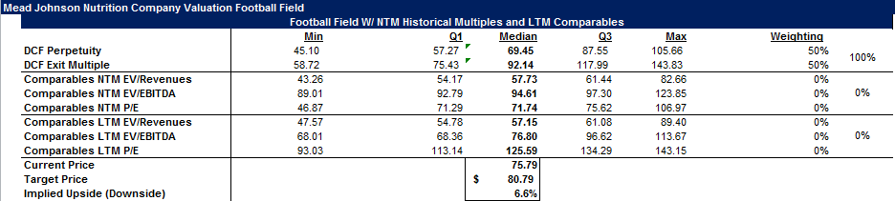
Football Field Metrics
Appendix

Slide 61
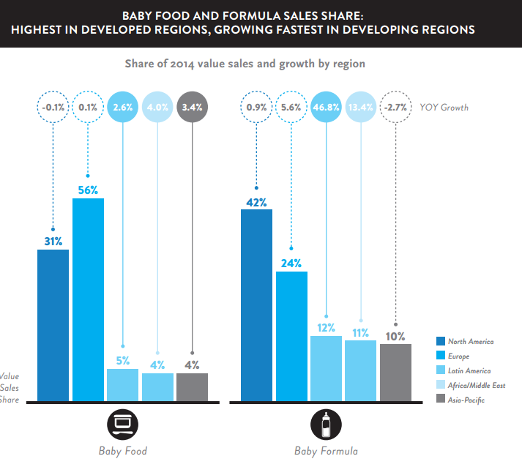
Baby Formula and Baby Food Sales Growth
Africa/Middle East growth projection was used from this
Appendix
Notes:
http://www.nielsen.com/content/dam/nielsenglobal/de/docs/Nielsen%20Global%20Baby%20Care%20Report%20-%20August%202015.pdf

Slide 62
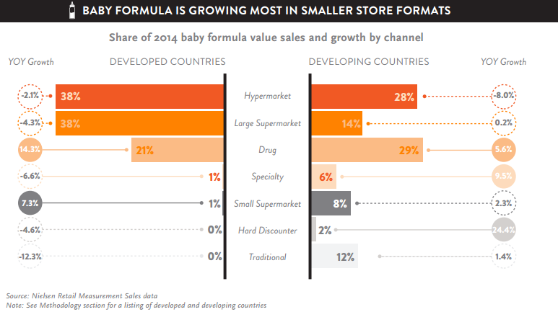
Store Formats Sales
Sales in drug stores benefits Enfamil and Similac the greatest
Both of these brands are considered more beneficial for heath; these two are the biggest premium brand names in the developed world
Appendix
Notes:
http://www.nielsen.com/content/dam/nielsenglobal/de/docs/Nielsen%20Global%20Baby%20Care%20Report%20-%20August%202015.pdf

Slide 63
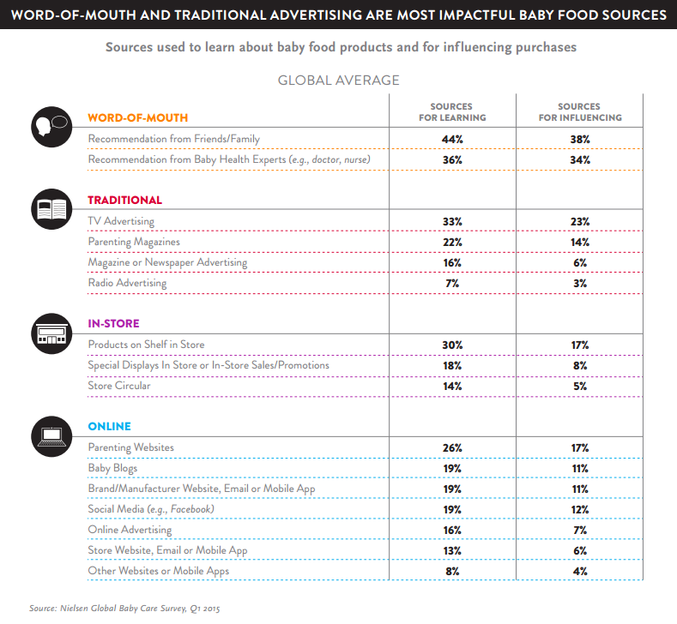
Marketing Avenues
Word-of-Mouth and recommendation is by far the biggest influencer of selling the product successfully
MJN has support from paediatricians from across the world
Ensuring a high quality product is the only way to ensure a positive word-of-mouth
MJN settled bribery claims of $12 million in July 2015 as a result of bribing health care professional to recommend their products to patients
This will only hurt MJN in the long run as consumer confidence in health care professionals will decrease
Appendix
Notes:
http://www.nielsen.com/content/dam/nielsenglobal/de/docs/Nielsen%20Global%20Baby%20Care%20Report%20-%20August%202015.pdf

Slide 64
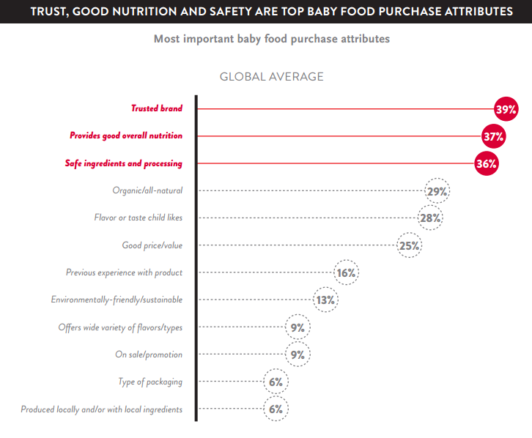
Most Important Selling Attributes
As expected, the most important attributes that concern parents are that of a trust brand which has a reputation of delivering nutrition to the child with the utmost care and safety
This is why the new product offering by MJN in China is so vital since it is FULLY imported
Another worrying trend is that organic food is listed as the fourth highest attribute on the list but MJN has no organic food offerings whatsoever – management is slacking yet once again
Appendix
Notes:
http://www.nielsen.com/content/dam/nielsenglobal/de/docs/Nielsen%20Global%20Baby%20Care%20Report%20-%20August%202015.pdf

Slide 65
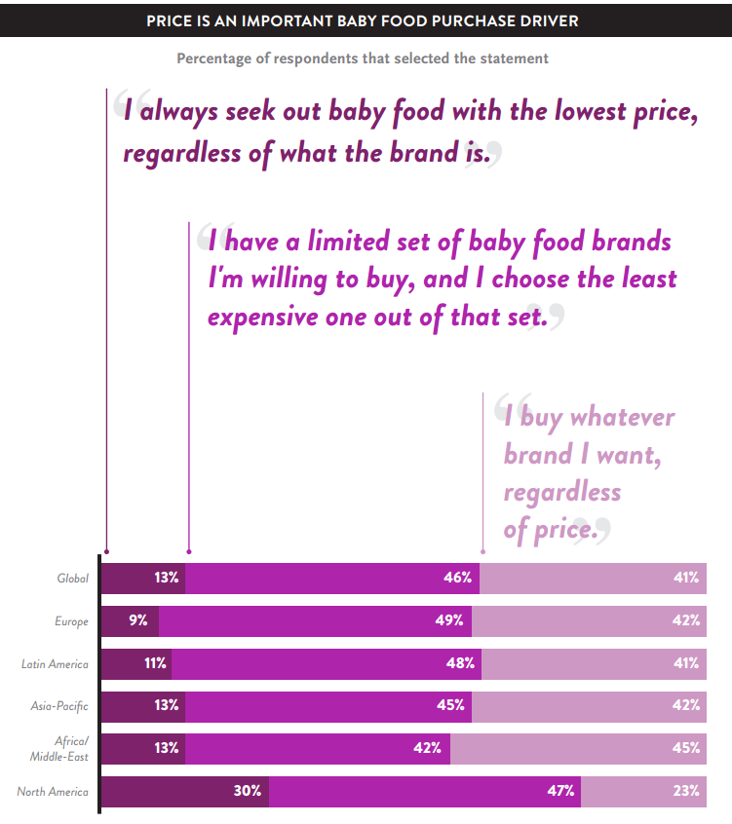
Price as a Factor
Price is much more important to parents in N.A than anywhere else in the world
This is likely due to the tough regulations and restrictions on formula products implemented by government agencies like the FDA
All formula products are tested before launching and the process in itself is very rigorous so it makes sense that customers would be less concerned about bad quality/unsafe formula in N.A than other parts of the world
In places like Asia-Pacific and Latin America, customer confidence has shattered so they are willing to pay a premium for quality brands regardless of the cost due to prior incidents
Appendix
Notes:
http://www.nielsen.com/content/dam/nielsenglobal/de/docs/Nielsen%20Global%20Baby%20Care%20Report%20-%20August%202015.pdf

Slide 66
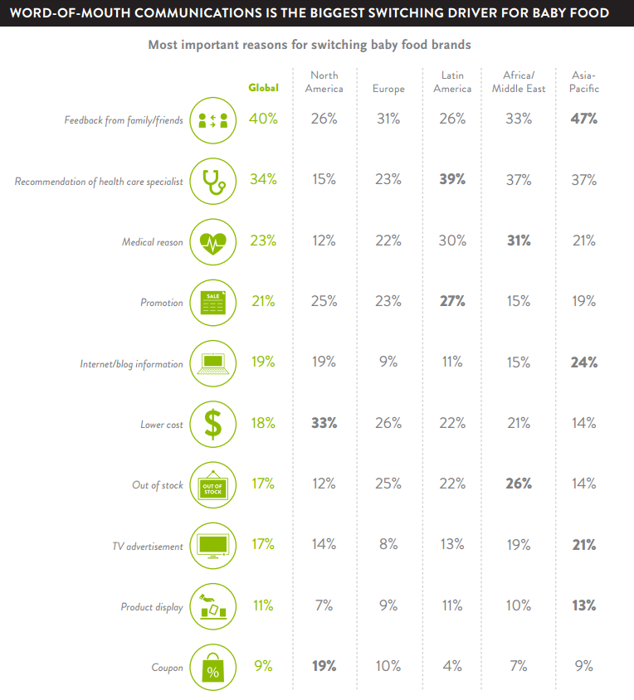
Drivers for Switching Brands
Word-of-Mouth is once again the top reason why customers would buy a certain type of product
Good quality is therefore of utmost importance since word-of-mouth trumps even recommendations of heath care professionals globally
Charging lower prices and engaging in price wars outside of North America is not a good strategy at all as customers are more than willing to pay higher premiums on those products
Appendix
Notes:
http://www.nielsen.com/content/dam/nielsenglobal/de/docs/Nielsen%20Global%20Baby%20Care%20Report%20-%20August%202015.pdf

Slide 67
Short Interest
Note: As a % of share price
67
Appendix

Slide 68
Mead Johnson Nutrition Other Metrics
Diluted EPS
Levered Free Cash Flow
CAGR = 6%
CAGR = 6%
EBIT/Interest Expense
Net Income Margin
68
Appendix

Slide 69
Mead Johnson Nutrition Historical EV/EBITDA
EV/EBITDA
69
Appendix

Slide 70
Mead Johnson Nutrition Historical P/E
P/E
70
Appendix
Notes:
The large drop off in P/E is attributable to Mondelez’s P/E dropping off due to their Q3 Earnings being stronger than expected
Only 14 constituents in the food products subsector

Slide 71
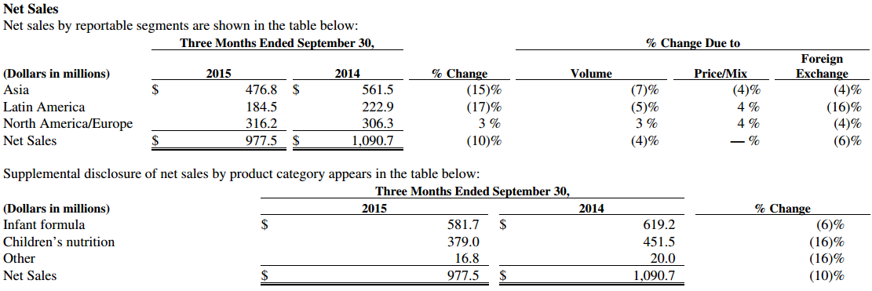
Mead Johnson’s YoY Sales - Asia
Asia
Shift in consumer demand for imported products due to the Chinese Milk Scandals which reduced sales for local dairy products by 30-40% so MJN’s locally manufactured brands are suffering
Recent launch of a fully imported brand is performing well in China however
Baby food demand has increased by more than 10 fold in China within a decade
One-Child policy in China is ending which should fuel growth for infant formula products
“White Gold” rush in China where Australian companies are making exaggerated claims of baby formulas boosting infant brain development and health
71
Appendix

Slide 72
Mead Johnson’s YoY Sales – Americas and Europe
Latin America
USD strengthening against the Mexican Peso has decreased sales substantially
Soft economic conditions in Argentina and Colombia hurt sales as well
North America and Europe
USD vs. CAD was unfavourable for the sales of the company
Improved market share positions also contributed to an increase in revenue numbers
72
Appendix

Slide 73
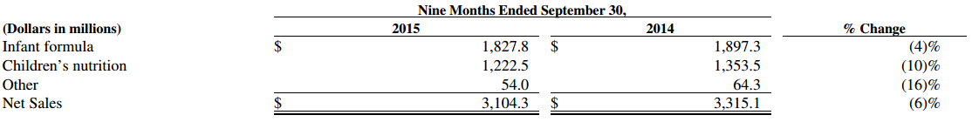
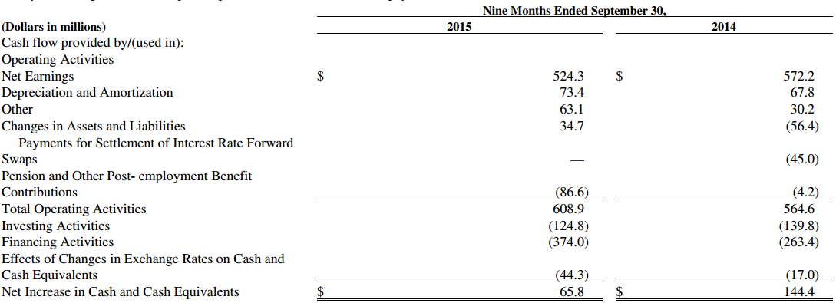
Mead Johnson’s Sales by Product and CF Statement
$437m used to repurchase shares; $244m used for dividend payments; $322m credit line borrowings utilized
73
Appendix

Slide 74
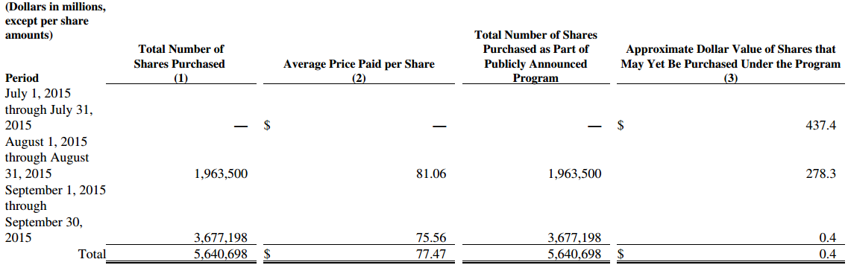
2015 Repurchase Authorization
On October 20, 2015, the Company’s board of directors approved a new share repurchase authorization of $1.5 billion of the Company’s common stock (the “2015 Repurchase Authorization”)
The Company expects to finance the share repurchases through the issuance of debt, which may include long- term notes
Shares will be repurchased from time to time in the open market or in privately negotiated transactions, including without limitation, the anticipated use of a $1.0 billion accelerated share repurchase program
The Company expects to enter into a $1.0 billion accelerated share repurchase agreement (the “ASR Agreement”) in the short- term with an investment bank
Under the ASR Agreement, approximately 11 million shares will be received by the Company once the ASR Agreement is executed
74
Appendix

Slide 75
Repurchase Plan’s Affect on Credit Rating
"The decision to intentionally leverage the balance sheet through share repurchases is an unfavourable shift in financial policy that weakens Mead's credit profile; however, there is sufficient cushion in the Baa1 rating to withstand the higher leverage, supported by the company's high cash balances, low starting leverage, and strong free cash flow," commented Brian Weddington, a Moody's Senior Credit Officer.
Debt/EBITDA rose to about 2.9x from 1.9x and net debt/EBITDA, net of approximately $1.4 billion of cash, increased to around 1.6x from 0.7x
The Baa1 long-term debt rating of Mead Johnson Nutrition Co. reflects the company's strong credit metrics, including operating profit margin in excess of 20%, retained cash flow to net/debt over 25%, and annual free cash flow over $300 million. The rating also is supported by the leading position of its "Enfa"-branded global paediatric nutrition franchise that generates a solid base of sales and earnings in the U.S. and has a strong and growing presence in emerging Asian and Latin American markets where over 70% of sales is generated. These strengths are balanced against key risk factors that include high category concentration in confidence-sensitive paediatric nutrition and high exposure to commodity input price and foreign currency volatility, especially in Asian and Latin American markets, that can cause price instability.
75
Appendix

Slide 76
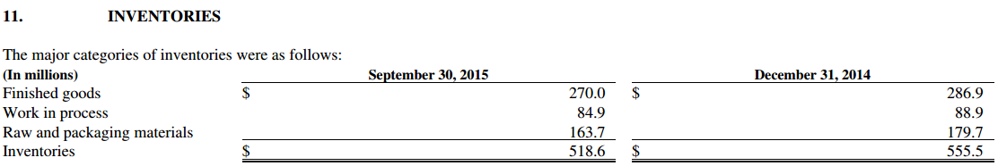
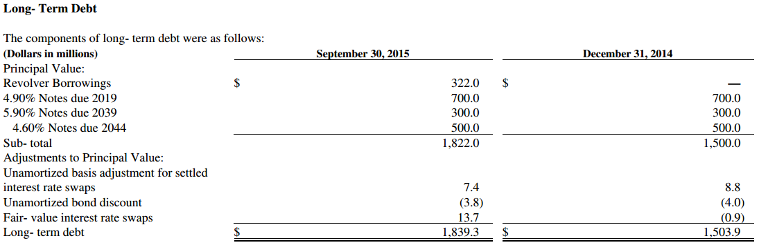
Inventories and Debt Breakdown
Five year revolving credit had interest rate of 1.3%; unsecured and repayable in June 2019; $750M is the max available amount; total debt to EBITDA cannot exceed more than 3.5:1.0 (currently at 2.9); EBITDA to total interest cannot be less than 3:1 (currently at 15:1); Used to repurchase shares
76
Appendix

Slide 77
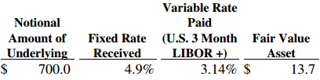
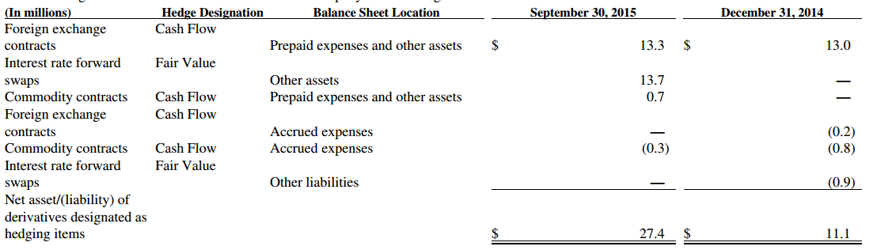
Hedging Activity
The Company uses foreign exchange contracts to hedge forecasted transactions, primarily foreign currency denominated inter- company purchases anticipated in the next 18 months and designates these derivative instruments as foreign currency cash flow hedges when appropriate
The forward starting swaps effectively mitigated the interest rate exposure associated with the Company’s offering of the 2044 Notes, the proceeds of which were used to redeem all of the Company’s 2014 Notes
The Company utilizes commodity hedges to minimize the variability in cash flows due to fluctuations in market prices of the Company’s non- fat dry milk purchases for North America
The following hedges are recorded at fair value
77
Appendix

Slide 78
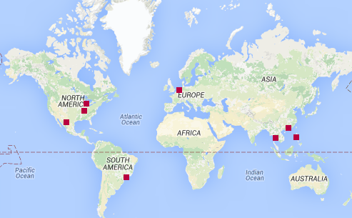
Mead Johnson’s Manufacturing Facilities
With more than 70 products in over 50 markets worldwide, Mead Johnson manufactures products for infants, children and adults all over the world
78
Appendix

Slide 79
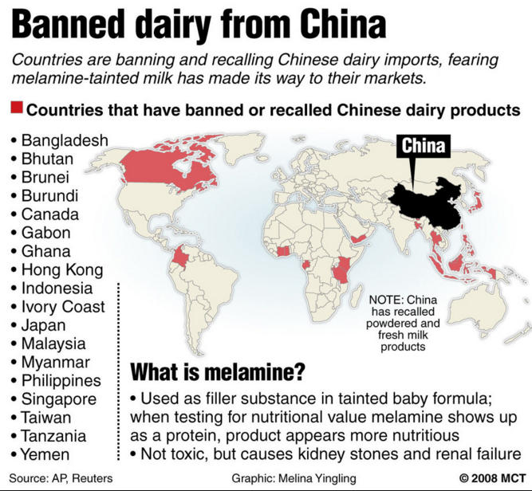
2008 Chinese Milk Scandal
2008 Chinese Milk Scandal which killed 6 babies and infected 300,000 more with melamine (used to manufacture plastic) which caused severe kidney problems such as kidney stones
The controls tests used to test for protein levels fails to distinguish between nitrogen in melanin and naturally occurring nitrogen in amino acids
Just four years prior to this, 13 infants had died from malnutrition due to watered-down milk
Aftermath:
11 countries stopped importing dairy products from China
Two people got executed by the Chinese government (Dairy farmer + manager of a milk production center)
79
Appendix

Slide 80
Historical DPS and Dividend Yield
80
Appendix
Notes:
The decrease in DPS and dividend yield from 2011 to 2012 was caused by the corporation changing to a share corporation which meant that they got taxed more heavily starting in 2011

Slide 81
Hold – Mead Johnson Nutrition (NYSE: MJN)
Company Overview
Share Performance
Leading infant formula manufacturer and distributor
Market Statistics
Revenue by Segment
Share Price (C$) | $75.79
Market Cap ($M) | $13,410
Net Debt ($M) | $1322
P/E NTM | 22.1x
EV/EBITDA NTM | 14.9x
EV/REVENUE NTM | 4.0x
ROC | 26%
Dividend Yield | 2.3%
Beta (5 Year) | 0.98
Valuation
Investment Considerations
Bear
$51.91
Base
$80.79
Bull
$124.74
Drivers
China’s two child policy enactment
High barriers to entry within industry (oligopoly)
Dairy prices projected to further decline
Risks
Changing consumer preferences
Management is late reacting to ongoing trends
Least diversified company among its competitors
Monthly VaR (5%) (-6.73%) Quarterly EPS: Q1 Q2 Q3 Q4
2015 A 1.09 0.76 0.80 0.78
2016 E 0.92e 0.87e
VaR Monthly (5%) – (8.24)%

Slide 82
Appendix Map
Market Share
Population Growth Assumptions
Sensitivity Analysis
Repo Authorization
Industry Risks
Correlation Matrix
EPS Estimates
Credit Rating
Investment Risks
Baby Formula Info
Capital Structure & Payout Policy
Hedges
Comps
Bear & Bull Assumptions
Ownership & Management
Chinese Milk Scandal
Revenue Assumptions
VaR
Football Field Metrics
WACC
Synutra Collapse
Global Industry Trends
DCF Base
MJN's Share Price Performance Factors
Short Interest
Regression Beta
More MJN Metrics
Full Comps
Excerpts From 10K
82

